Slide 1
DATA STRUCTURES
TREES

Slide 2
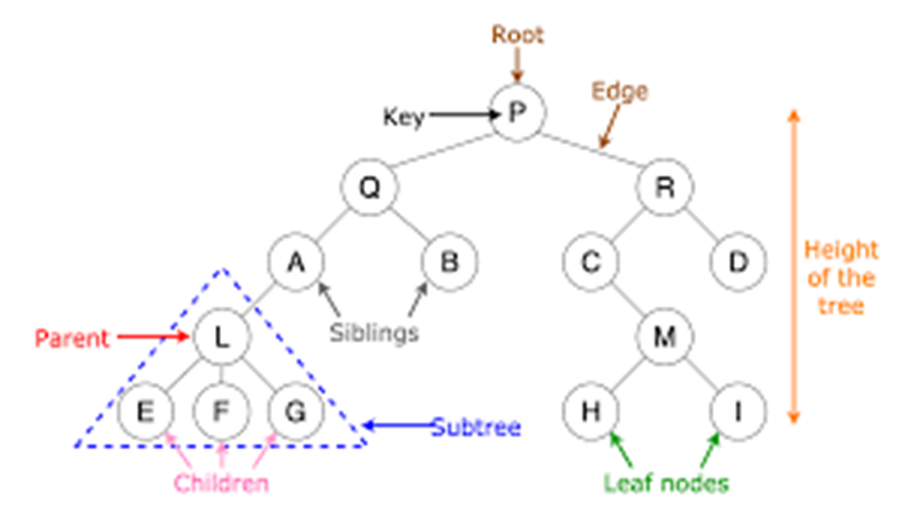
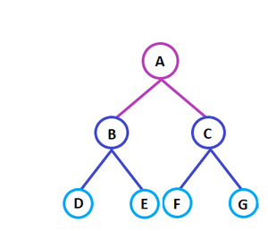
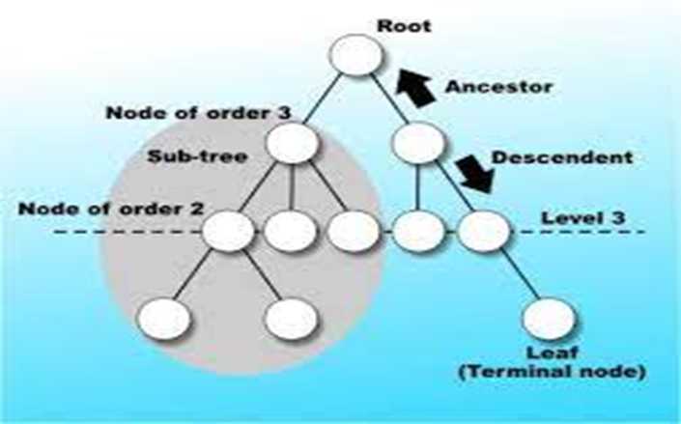
What Is A Tree?
A tree is non-linear and a hierarchical data structure consisting of a collection of nodes such that each node of the tree stores a value and a list of references to other nodes (the “children”).

Slide 3

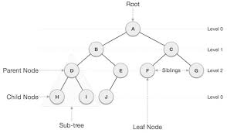
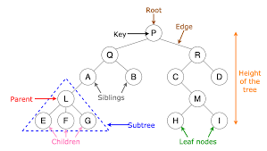
Tree

Slide 4
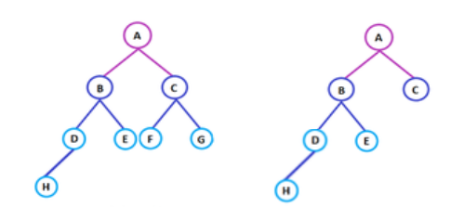
Types of Tree
The different types of tree data structures are as follows:
1. General tree
A general tree data structure has no restriction on the number of nodes. It means that a parent node can have any number of child nodes.
2. Binary tree
A node of a binary tree can have a maximum of two child nodes. In the given tree diagram, node B, D, and F are left children, while E, C, and G are the right children.

Slide 5
Types of Tree
3. Balanced tree
If the height of the left sub-tree and the right sub-tree is equal or differs at most by 1, the tree is known as a balanced tree.
4. Binary search tree
As the name implies, binary search trees are used for various searching and sorting algorithms. The examples include AVL tree and red-black tree. It is a non-linear data structure. It shows that the value of the left node is less than its parent, while the value of the right node is greater than its parent.

Slide 6
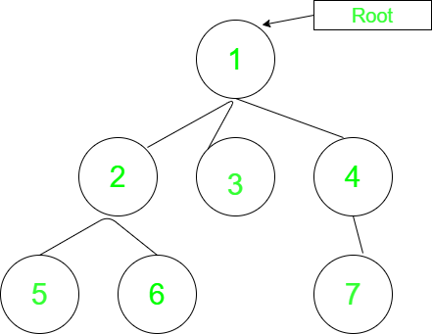
Basic Operation Of Tree:
Create – create a tree in data structure.
Insert − Inserts data in a tree.
Search − Searches specific data in a tree to check it is present or not.

Slide 7
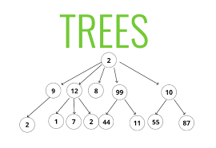
Basic Operation Of Tree:
Preorder Traversal – perform Traveling a tree in a pre-order manner in data structure .
In order Traversal – perform Traveling a tree in an in-order manner.
Post order Traversal –perform Traveling a tree in a post-order manner.

Slide 8


